Slide 1

Tree-based Method
Brief Introduction to The
Classification And Regression Tree (CART)
& The Bagging Approach (Random Forest)
林成鍇 Julius Ling @ 國立成功大學大數據與AI研究中心

Slide 2

to Prof. Po-Hsien Huang

Slide 3
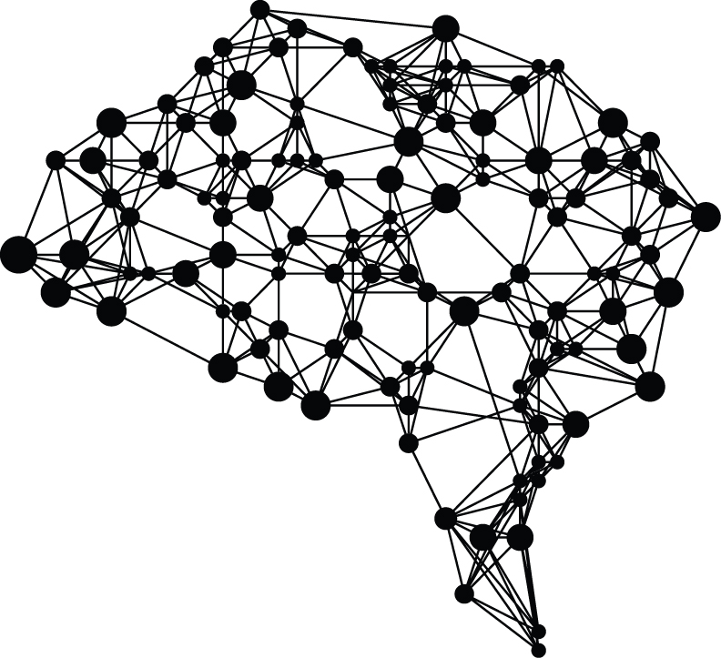
Outline
Decision Tree
Random Forest

Slide 4
Outline
Decision Tree
Random Forest

Slide 5

Decision Tree
The Development of CART
Intuitive Understanding & Visualization of The Model
Underneath The Bonnet (Classification)
Underneath The Bonnet (Regression)
Practical Issues

Slide 6
Decision Tree
The Development of CART
Intuitive Understanding & Visualization of The Model
Underneath The Bonnet (Classification)
Underneath The Bonnet (Regression)
Practical Issues

Slide 7
The Development of CART
ID3
C4.5
Classification And
Regression Tree (CART)

Slide 8
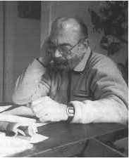
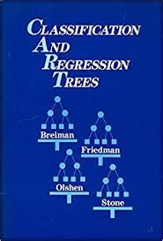
Leo Breiman (1928-2005)
& CART (1984)

Slide 9
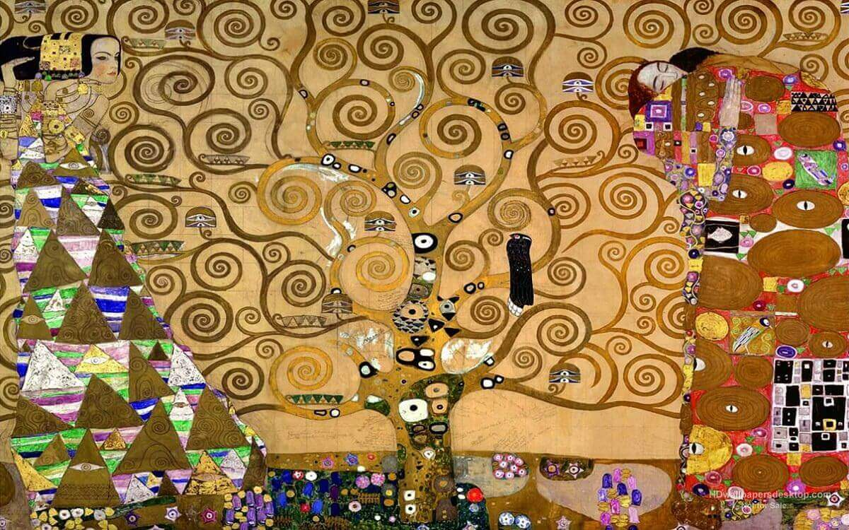
Decision Tree
The Tree of Life, Stoclet Frieze, 1905 by Gustav Klimt
The Development of CART
Intuitive Understanding & Visualization of The Model
Underneath The Bonnet (Classification)
Underneath The Bonnet (Regression)
Practical Issues

Slide 10
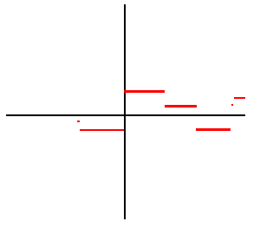
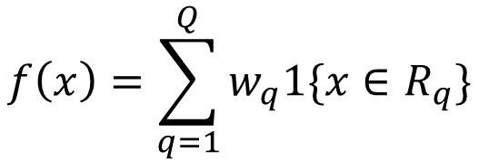
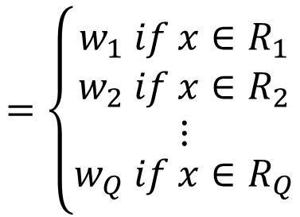
Simple Function
f(x) is a sequence of simple function defined on a finite domain:
$$f\left(x\right)=\sum_{q=1}^{Q}{w_{q}1\{x∈R_{q}\}}$$
Indicator Function
$$=\left\{\begin{matrix}w_{1} if x∈R_{1} \\ \begin{matrix}w_{2} if x∈R_{2} \\ ⋮\end{matrix} \\ w_{Q} if x∈R_{Q}\end{matrix}\right.$$
Any continuous function can be approximated by a sequence of simple function.

Slide 11
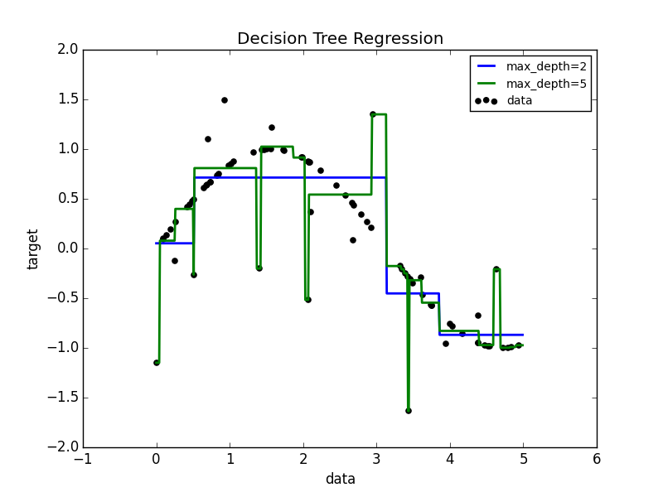
Regression Tree (Univariate)

Slide 12
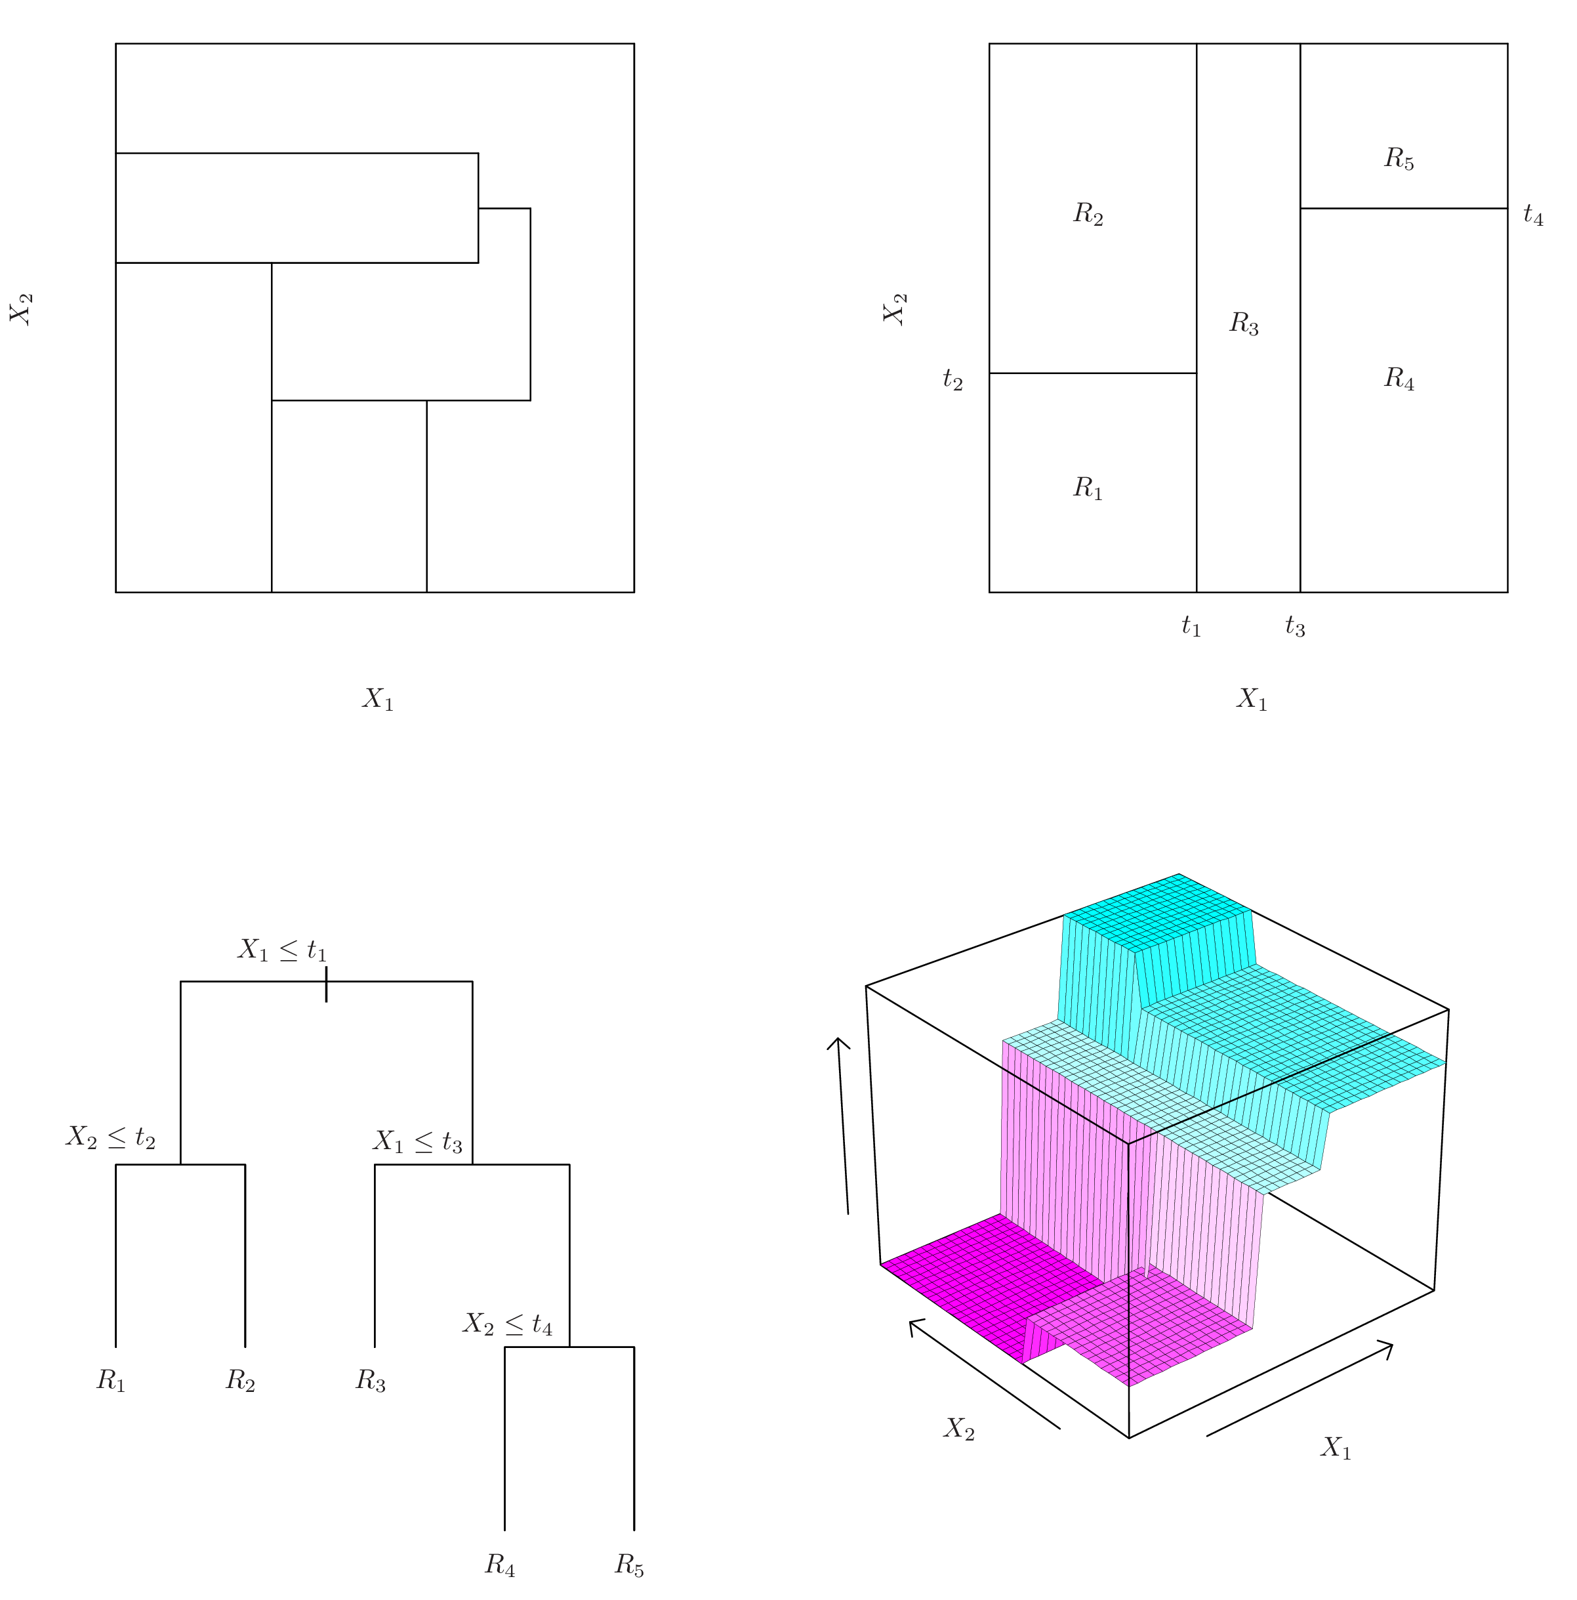
Regression Tree
(Bivariate)

Slide 13
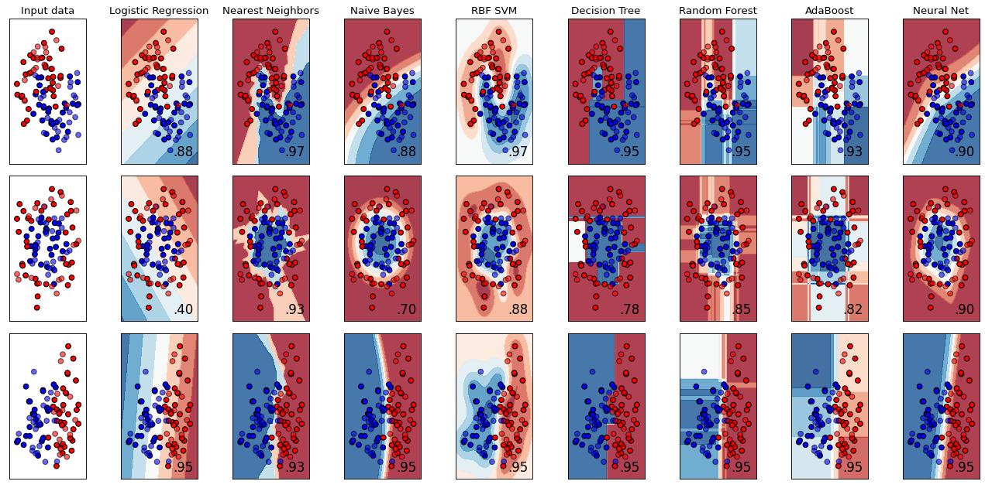
Classification Tree
Source: https://scikit-learn.org/stable/auto_examples/classification/plot_classifier_comparison.html

Slide 14
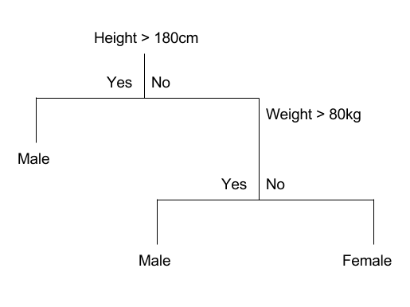
Classification Tree

Slide 15
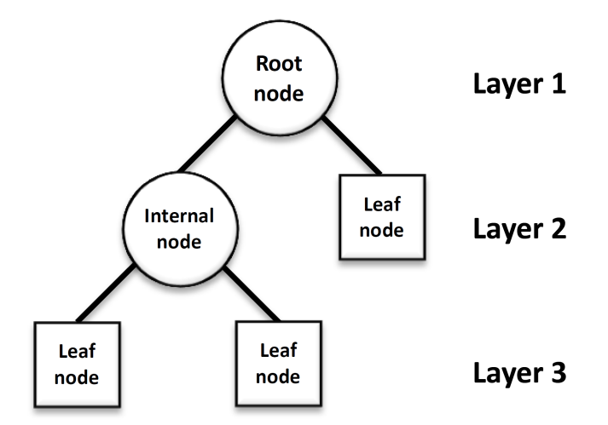
Tree Structures
Depth

Slide 16
Decision Tree
The Development of CART
Intuitive Understanding & Visualization of The Model
Underneath The Bonnet (Classification)
Underneath The Bonnet (Regression)
Practical Issues

Slide 17
Recursive Binary Splitting Algorithm

Slide 18

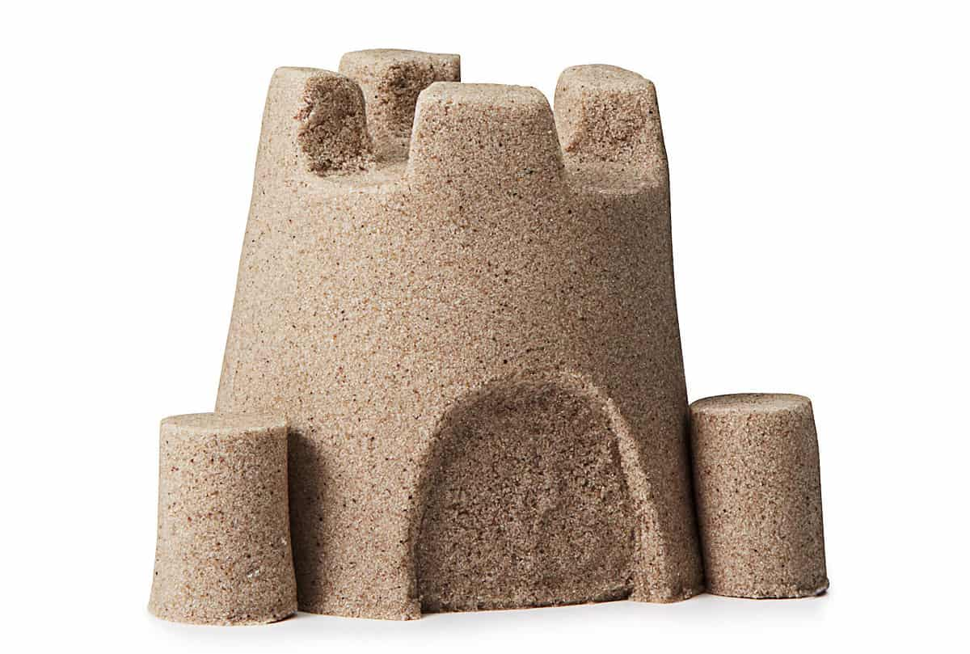

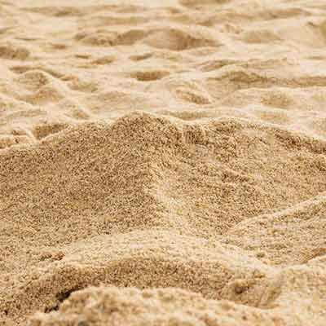
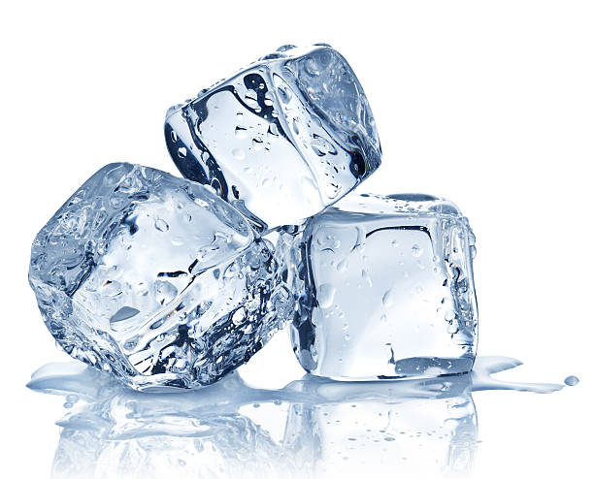
Entropy
My Life !
Lower Entropy
Higher Entropy

Slide 19
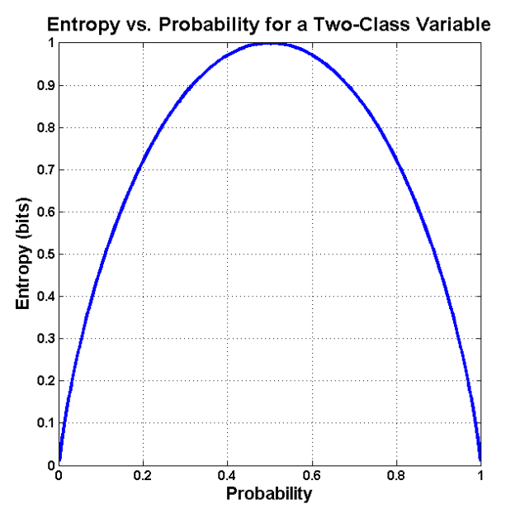
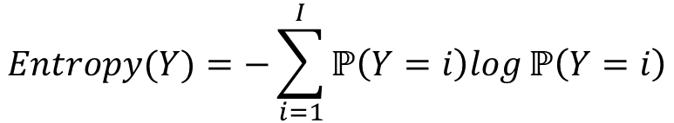
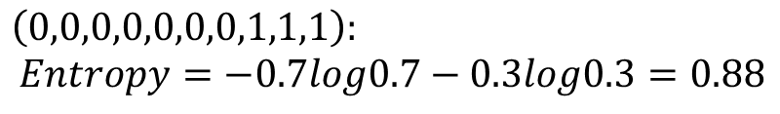
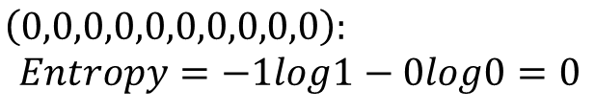
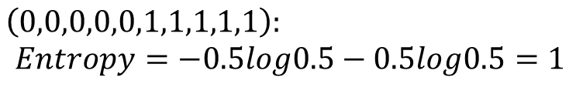
Entropy as Impurity Index
Given a random categorical variable Y with I classes:
$$Entropy(Y)=−\sum_{i=1}^{I}{ℙ\left(Y=i\right)log}ℙ\left(Y=i\right)$$
$$\left(0,0,0,0,0,1,1,1,1,1\right):$$
$$Entropy=−0.5log0.5−0.5log0.5=1$$
$$\left(0,0,0,0,0,0,0,1,1,1\right):$$
$$Entropy=−0.7log0.7−0.3log0.3=0.88$$
$$\left(0,0,0,0,0,0,0,0,0,0\right):$$
$$Entropy=−1log1−0log0=0$$

Slide 20
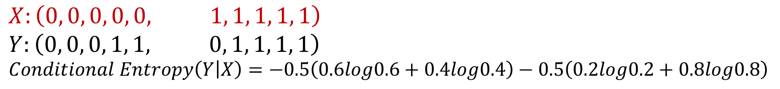
Conditional Entropy
Given a random categorical variable Y with I classes
& a random categorical predictor X with J classes:
$$Conditional Entropy(Y|X)=−\sum_{j=1}^{J}{ℙ\left(X=j\right)}\sum_{i=1}^{I}{ℙ\left(Y=i|X=j\right)log}ℙ\left(Y=i|X=j\right)$$
$$X:\left(0, 0, 0, 0, 0, 1, 1, 1, 1, 1\right)$$
$$Y:\left(0, 0, 0, 1, 1, 0, 1, 1, 1, 1\right)$$
$$Conditional Entropy\left(Y | X\right)=−0.5\left(0.6log0.6+0.4log0.4\right)−0.5\left(0.2log0.2+0.8log0.8\right)$$
This would work if X is a continuous variable as well.

Slide 21
Information Gain 信息增益
$$Info. Gain\left(Y,X\right)=Entropy\left(Y\right)−Conditional Entropy(Y|X)$$
The Info. Gain serves as a decision criterion to opt for the optimum threshold for ID3. The greater the Info. Gain, the greater the accuracy enhanced by choosing the classes of X as the decision threshold.
However, the tree would prone to opt for the predictor X of more classes, which is not preferable by the most.

Slide 22
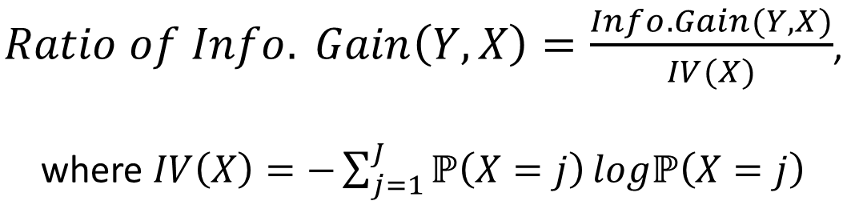
Ratio of Information Gain 信息增益比
$Ratio of Info. Gain\left(Y,X\right)=\frac{Info. Gain(Y,X)}{IV(X)}$,
where $IV\left(X\right)=−\sum_{j=1}^{J}{ℙ\left(X=j\right)}logℙ\left(X=j\right)$
C4.5 screens through the predictor(s) with the Information Gain greater than the average at first. The one with the highest Ratio of Information Gain is opted among these predictors.

Slide 23
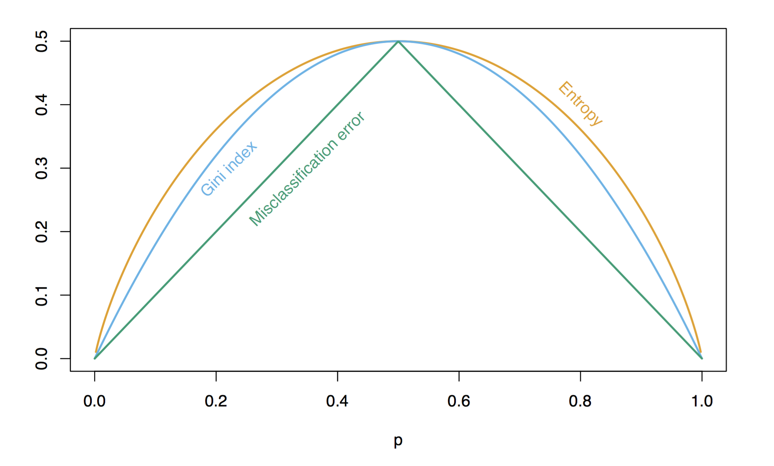
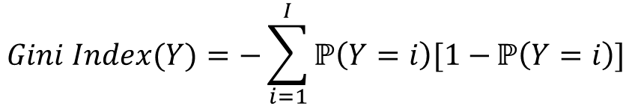
Gini Index 基尼指數 as The Impurity Index of CART
$$Gini Index(Y)=−\sum_{i=1}^{I}{ℙ\left(Y=i\right)[1−}ℙ\left(Y=i\right)]$$

Slide 24
Decision Tree
The Development of CART
Intuitive Understanding & Visualization of The Model
Underneath The Bonnet (Classification)
Underneath The Bonnet (Regression)
Practical Issues

Slide 26
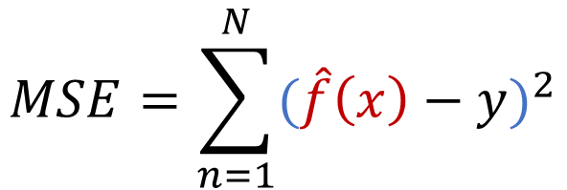
$$MSE=\sum_{n=1}^{N}{{(\hat{f}\left(x\right)−y)}^{2}}$$

Slide 27
Regression Tree (Univariate)

Slide 28
Regression Tree
(Bivariate)

Slide 29
Decision Tree
The Development of CART
Intuitive Understanding & Visualization of The Model
Underneath The Bonnet (Classification)
Underneath The Bonnet (Regression)
Practical Issues

Slide 30
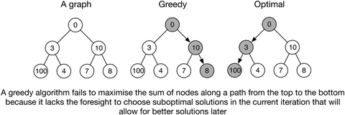
CART & Greediness
The best split is made at every tree-building step, rather then looking ahead and picking a split that will lead to a better tree in some future step. The outcome of CART algorithm is a Nash Equilibrium (but not necessarily a Subgame Perfect Equilibrium) under the framework of Game Theory.
https://besjournals.onlinelibrary.wiley.com/doi/full/10.1111/1365-2656.12963

Slide 31
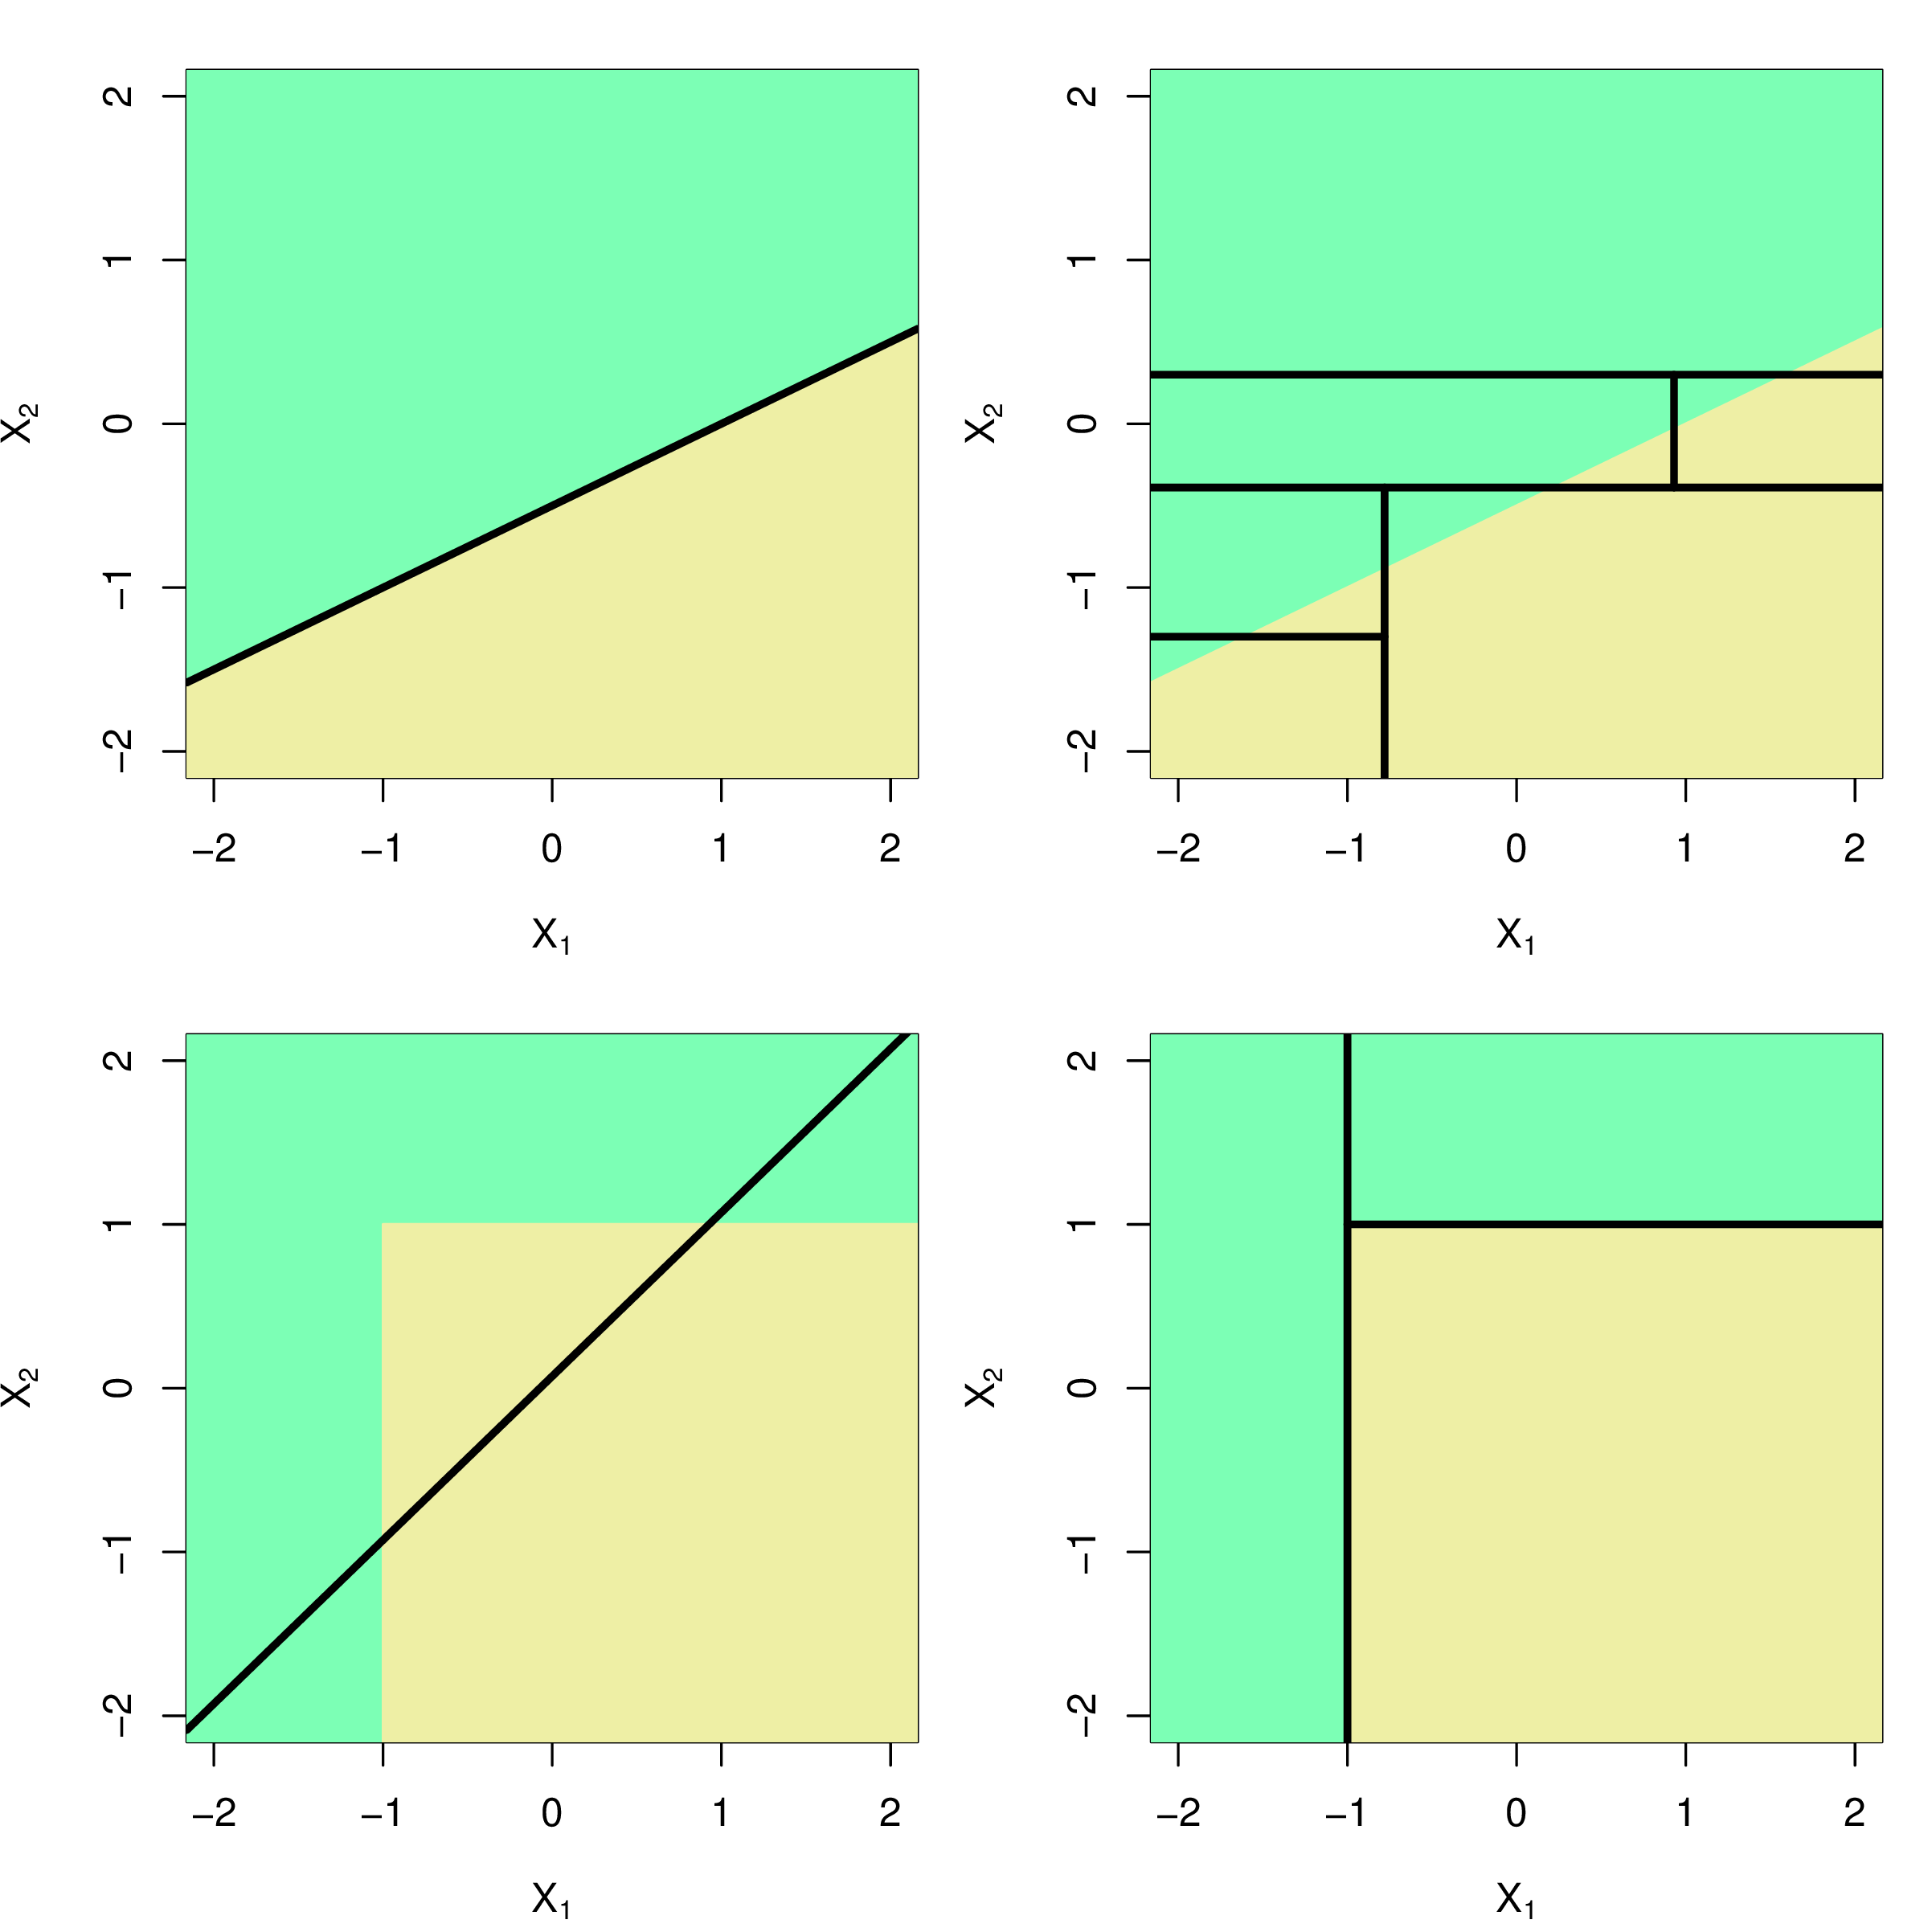

Why CART?
Girl with a Mandolin – Pablo Picasso 1910

Slide 32
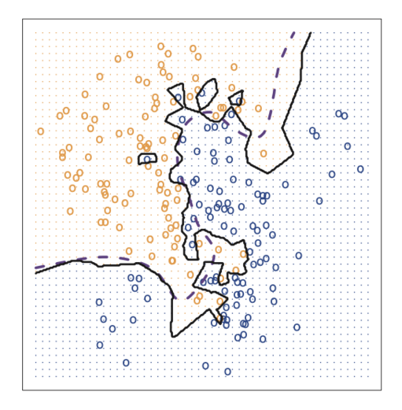
Instance-based / Non-parametric Approach
Girl with a Mandolin – Pablo Picasso 1910

Slide 33
The Data Modelling Approach
&
The Algorithmic Modelling Approach
Reference: Statistical modeling: The two cultures - L Breiman - Statistical science, 2001

Slide 34
CART & It’s Flexibility
It overfits easily.

Slide 35
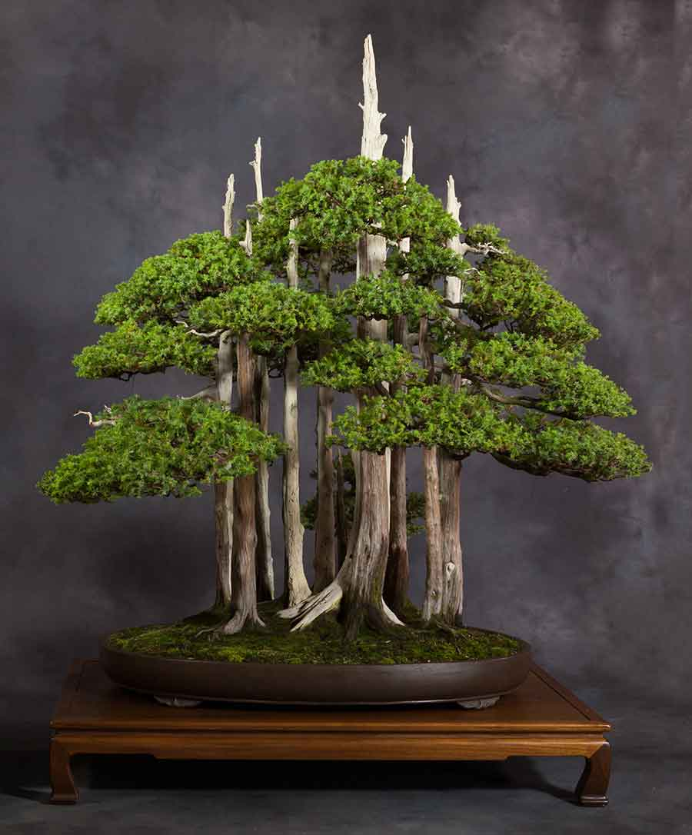
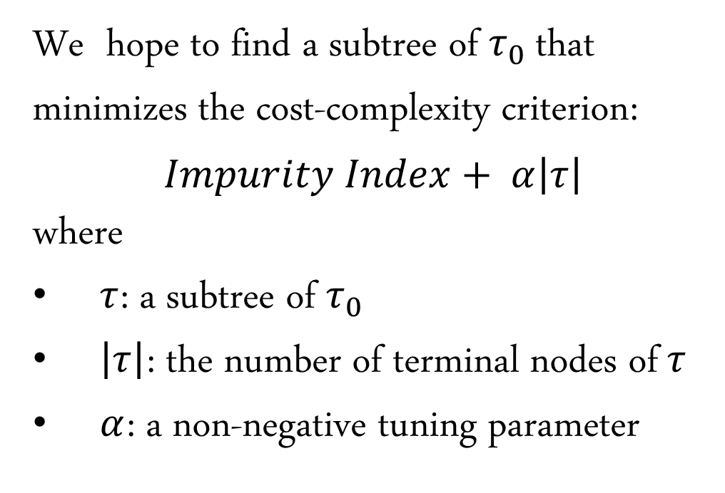
Cost-Complexity Pruning
For Generalization
We hope to find a subtree of $τ_{0}$ that minimizes the cost-complexity criterion:
$$Impurity Index+ α\left|τ\right|$$
where
$τ$: a subtree of $τ_{0}$
$\left|τ\right|$: the number of terminal nodes of$τ$
$α$: a non-negative tuning parameter

Slide 36
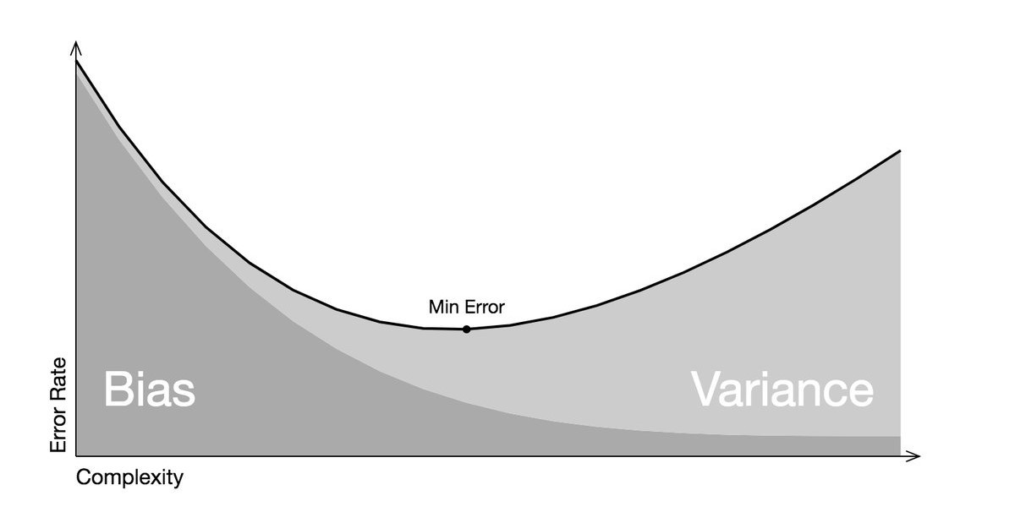
Bias-Variance Tradeoff

Slide 37
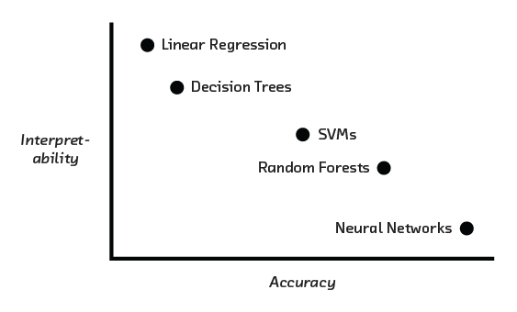
The High Interpretability of Decision Trees

Slide 38
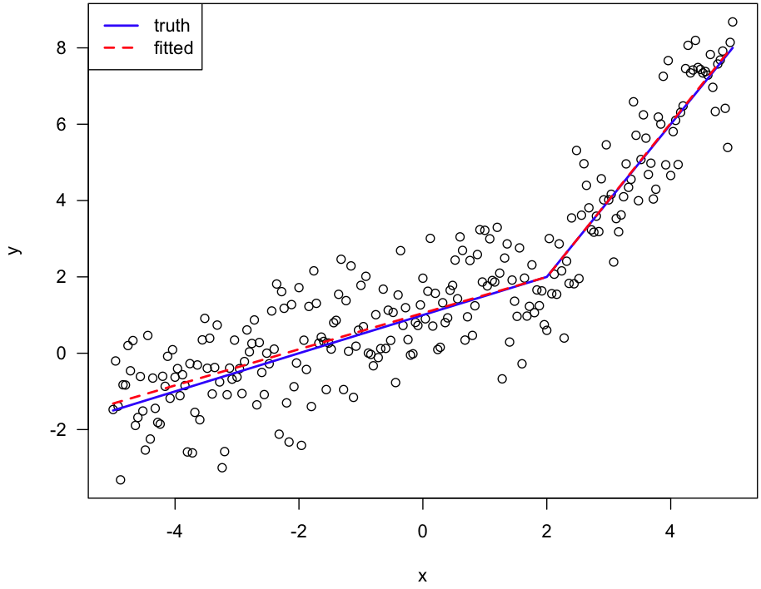
Decision Trees as Linear Predictor
(& It’s Relationship With Spline Regression)

Slide 39
Outline
Decision Tree
Random Forest

Slide 40
Random Forest
Bagging (Bootstrap Aggregation) & Boosting Method
Underneath The Bonnet (Bagging & Random Forest)
Model Interpretation

Slide 41
Random Forest
Bagging (Bootstrap Aggregation) & Boosting Method
Underneath The Bonnet (Bagging & Random Forest)
Model Interpretation

Slide 42
CART & It’s Flexibility
It overfits easily.

Slide 43
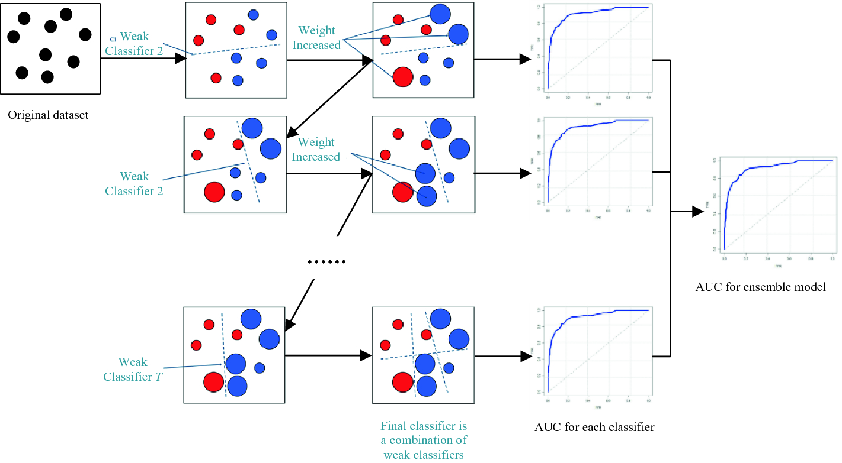

Boosting As Frankensteinian Ensemble Model
Made for a Party (1936)
– Hannah Höch

Slide 44
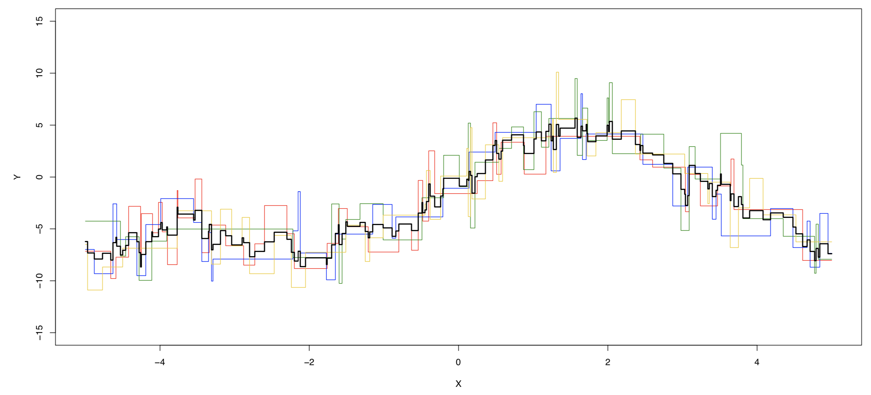
Bagging Approach (Bootstrap Aggregation)
Bootstrap Aggregation or Bagging averages the prediction over a collection of bootstrap samples, thereby reducing its variance.

Slide 45
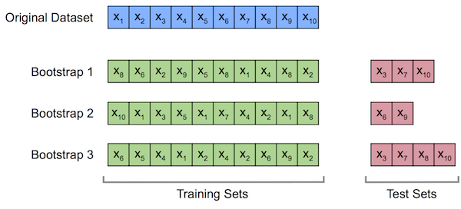
Bootstrap Resampling
OOB samples
These Out-Of-Bag (OOB) Samples (averagely 1/3 of the original samples) can be used to estimate the validation error.

Slide 46
Random Forest
Bagging (Bootstrap Aggregation) & Boosting Method
Underneath The Bonnet (Bagging & Random Forest)
Model Interpretation

Slide 47
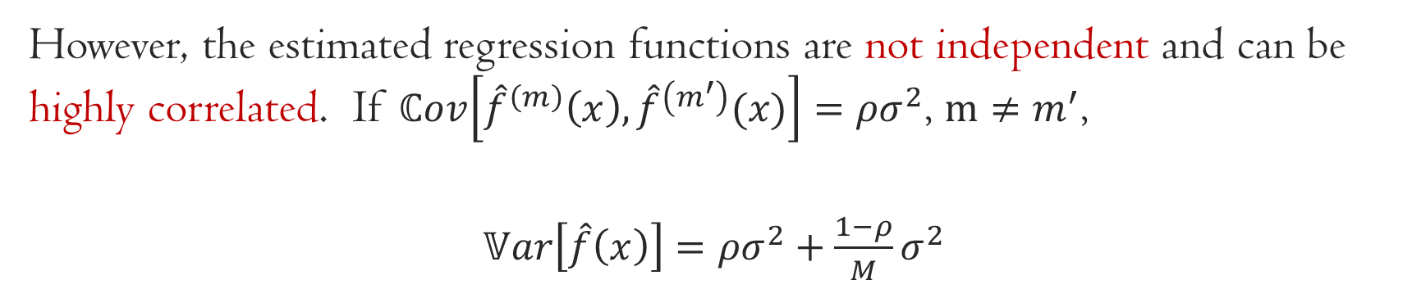
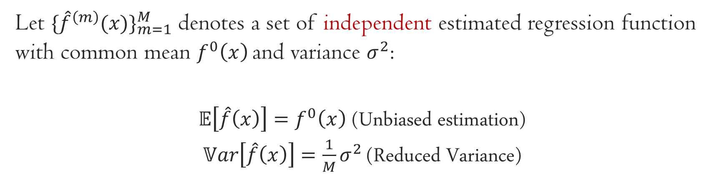
The Problem of Bagging Method
Let ${\{{\hat{f}}^{\left(m\right)}(x)\}}_{m=1}^{M}$ denotes a set of independent estimated regression function with common mean $f^{0}\left(x\right)$ and variance $σ^{2}$:
$𝔼\left[\hat{f}\left(x\right)\right]=f^{0}\left(x\right)$ (Unbiased estimation)
$𝕍ar\left[\hat{f}\left(x\right)\right]={\frac{1}{M}σ}^{2}$ (Reduced Variance)
However, the estimated regression functions are not independent and can be highly correlated. If $ℂov\left[{\hat{f}}^{\left(m\right)}\left(x\right),{\hat{f}}^{\left(m^{′}\right)}(x)\right]={ρσ}^{2}$, $m≠m^{′}$,
$𝕍ar\left[\hat{f}\left(x\right)\right]={ρσ}^{2}+{\frac{1−ρ}{M}σ}^{2}$

Slide 48
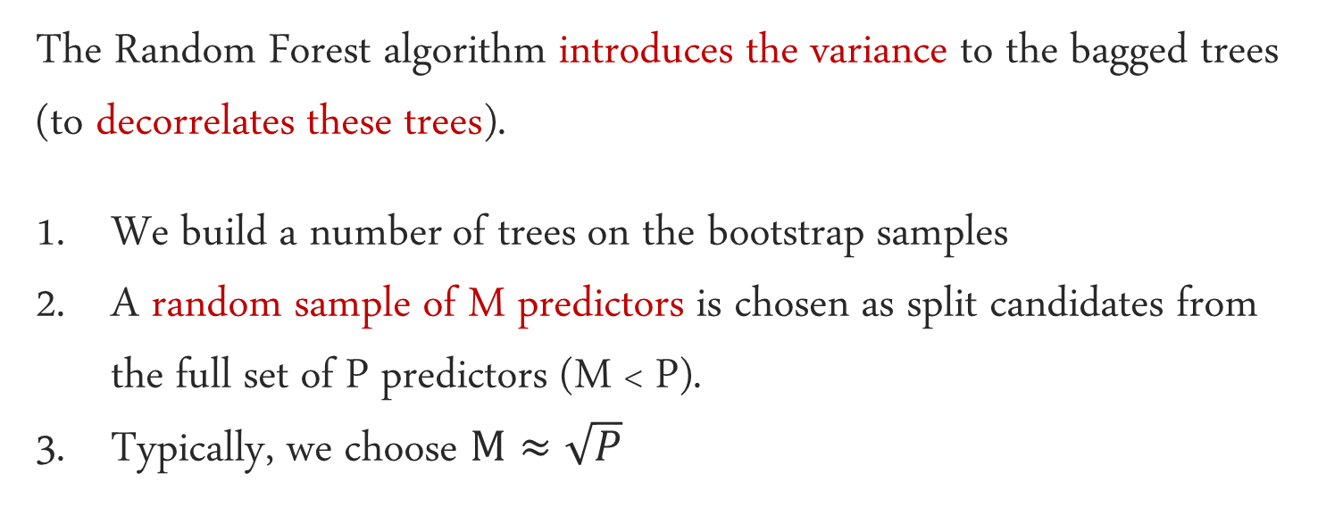
Random Forest
The Random Forest algorithm introduces the variance to the bagged trees (to decorrelates these trees).
We build a number of trees on the bootstrap samples
A random sample of M predictors is chosen as split candidates from the full set of P predictors (M < P).
Typically, we choose $M≈\sqrt{P}$

Slide 49
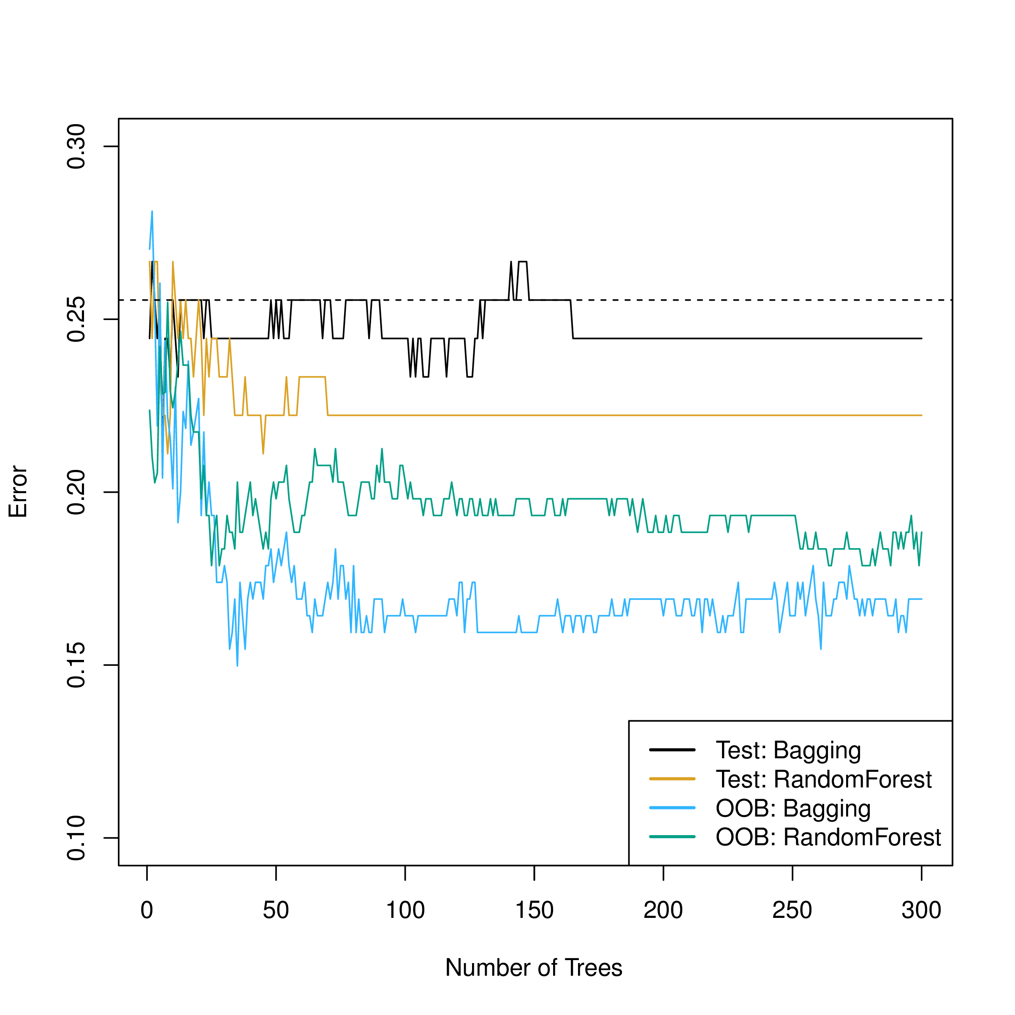
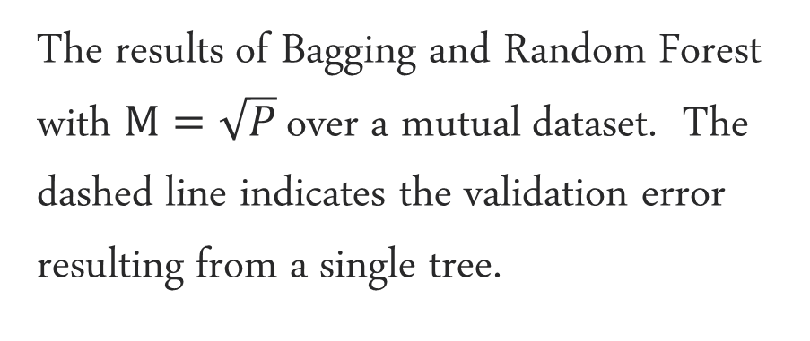
Bagging V.s. Random Forest
The results of Bagging and Random Forest with $M=\sqrt{P}$ over a mutual dataset. The dashed line indicates the validation error resulting from a single tree.

Slide 50
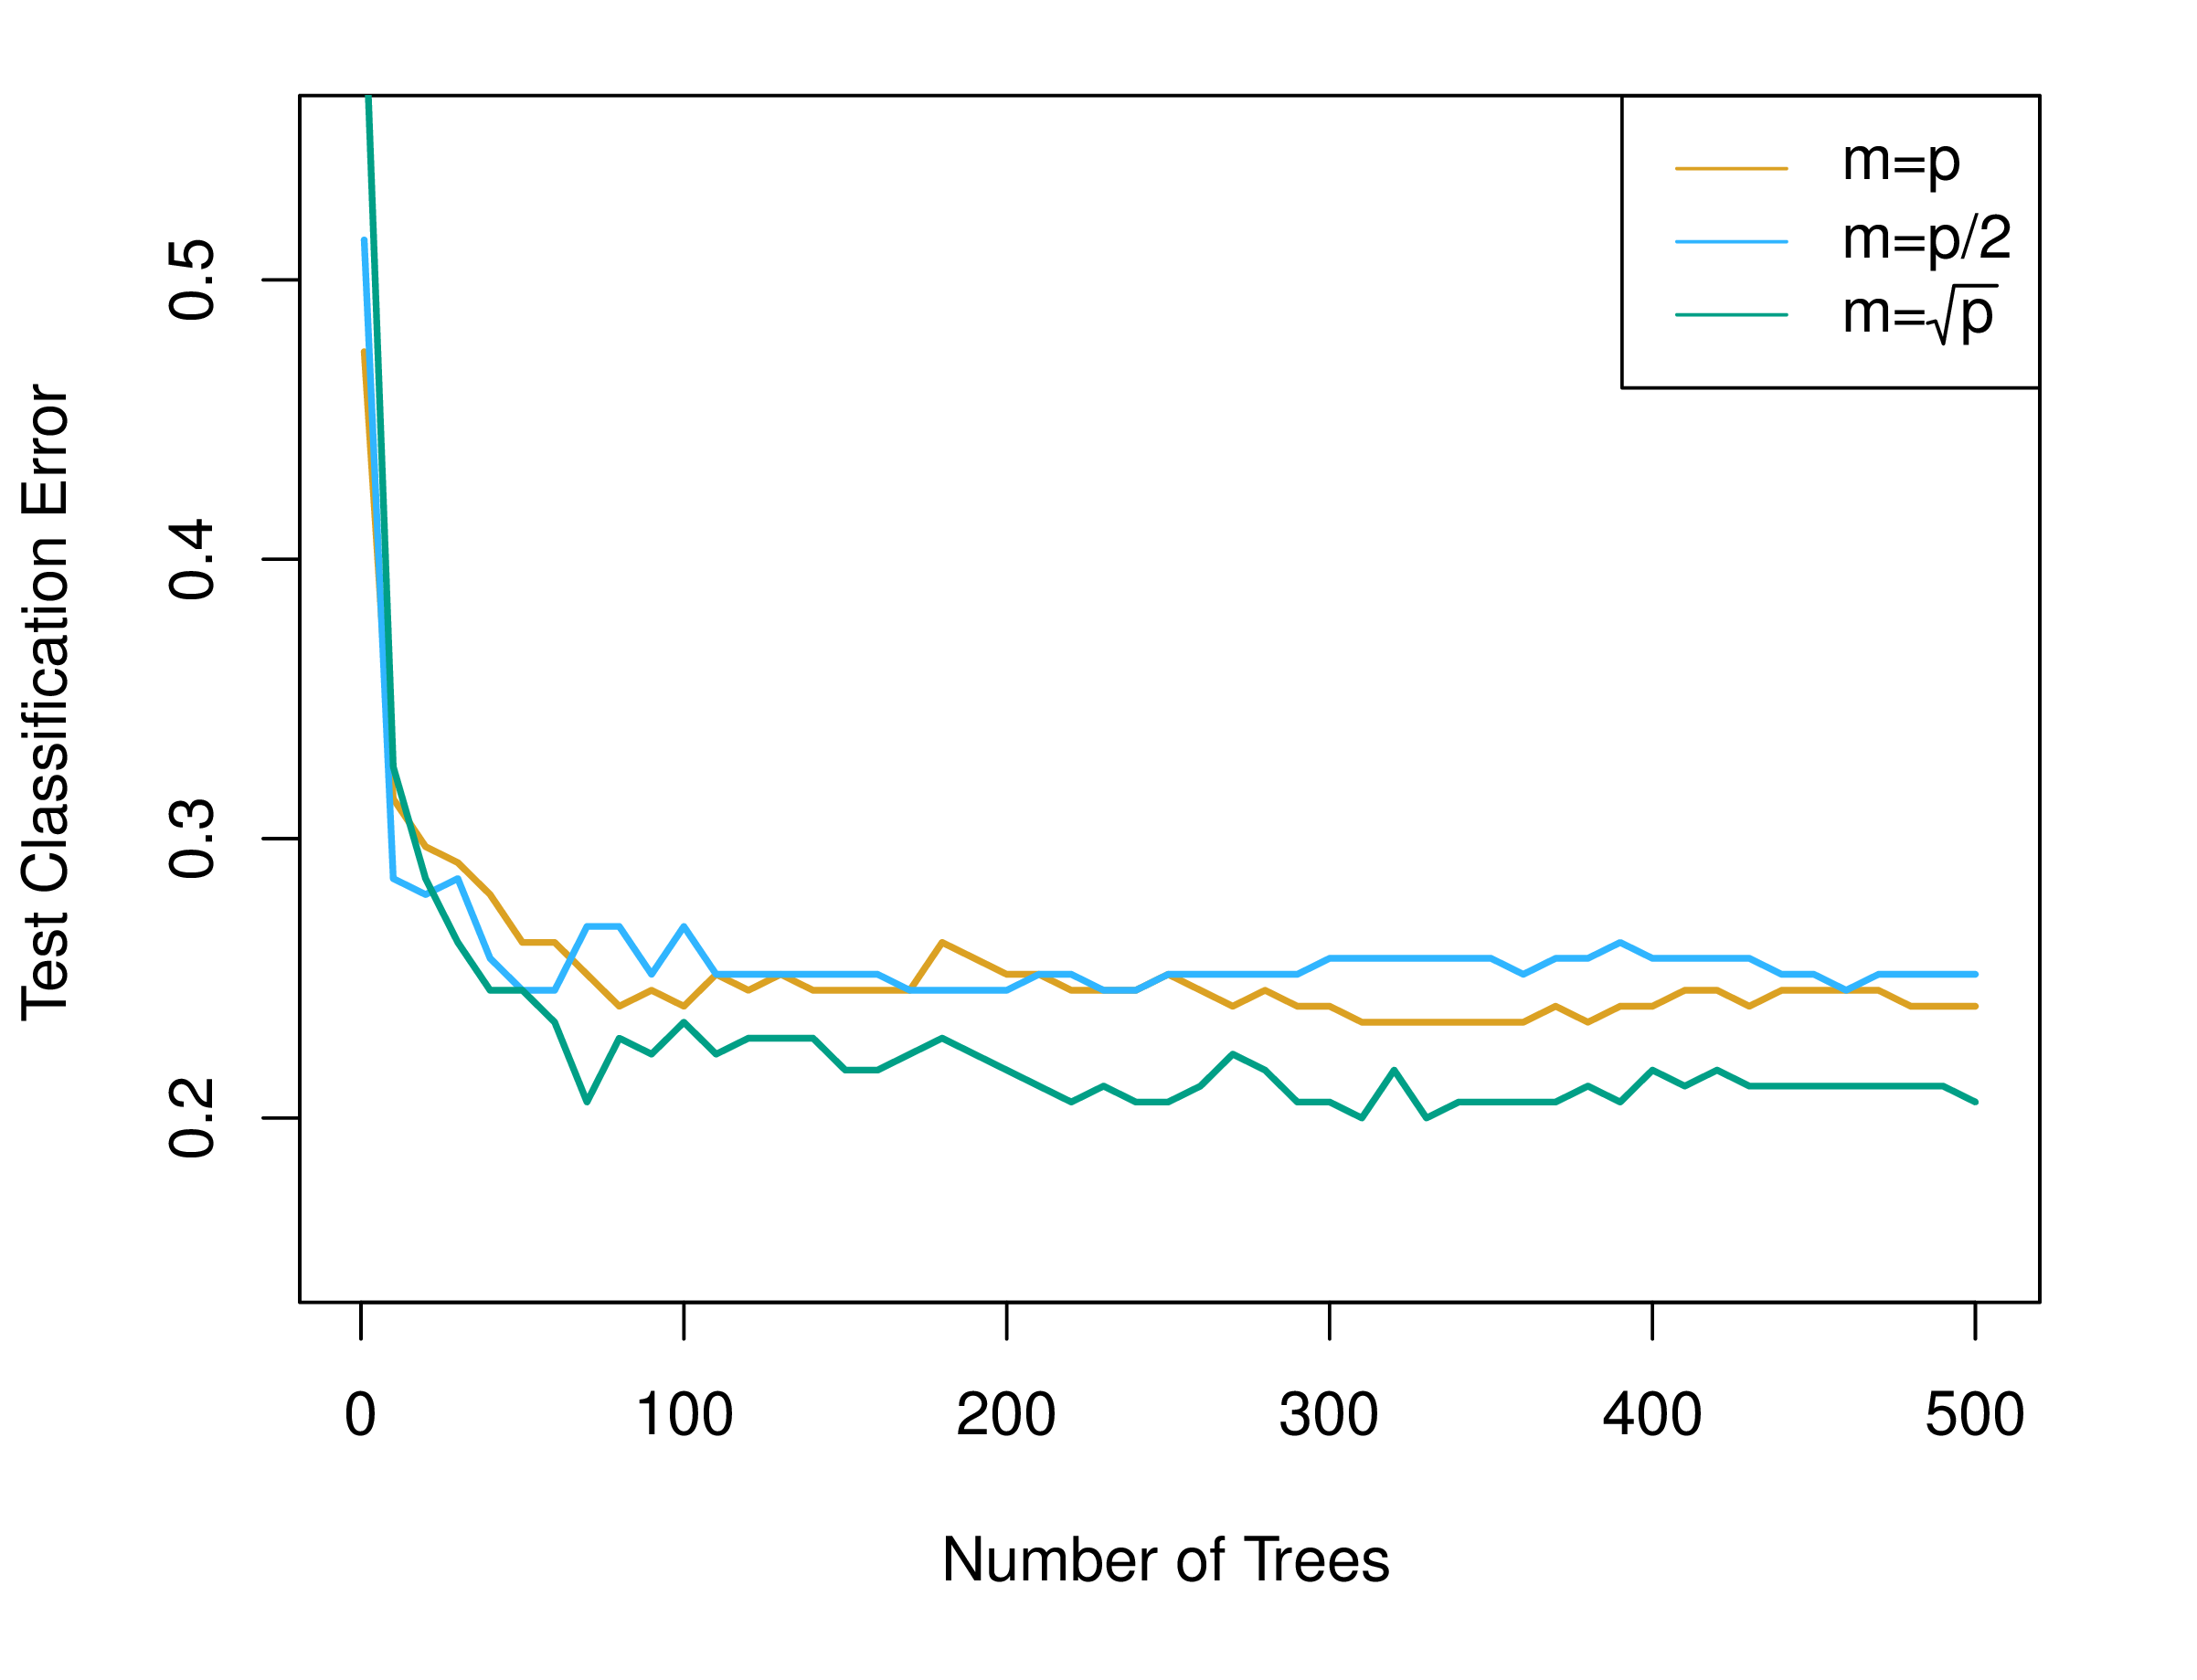
M As Tuning Parameter in Random Forest

Slide 51
Random Forest
Bagging (Bootstrap Aggregation) & Boosting Method
Underneath The Bonnet (Bagging & Random Forest)
Model Interpretation

Slide 52
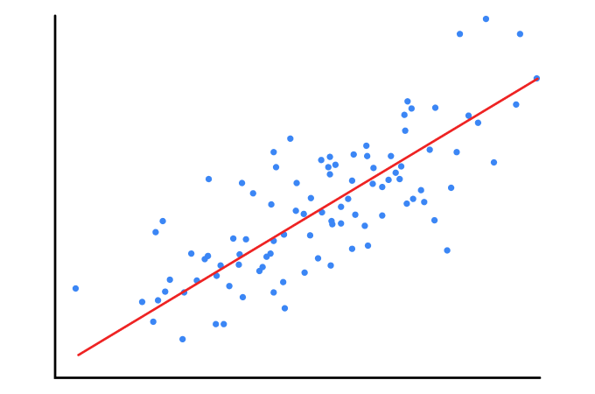
Relative Influence in Linear Regression
$$ℐ_{p}=\hat{w_{p}}𝕊D(X_{p})$$

Slide 53
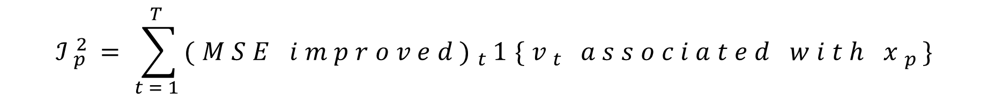
Relative Influence in Regression Tree
t-th nodes of a tree
$$ℐ_{p}^{2}=\sum_{t=1}^{T}{{(MSE improved)}_{t}1\{v_{t} associated with x_{p}\}}$$
Indicator Function

Slide 54
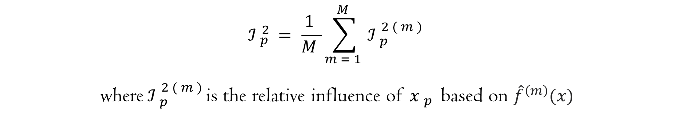
Relative Influence in Bagging & Random Forest
$$ℐ_{p}^{2}=\frac{1}{M}\sum_{m=1}^{M}{ℐ_{p}^{2(m)}}$$
where $ℐ_{p}^{2(m)}$is the relative influence of $x_{p}$ based on ${\hat{f}}^{\left(m\right)}(x)$

Slide 55
The Low Interpretability of Random Forest

Slide 56

Dataset
Prediction
Machine Learning Model are often regarded as Black Boxes for its Low Interpretability. We wish to know the behavior of a model——how a certain prediction is made.

Slide 57
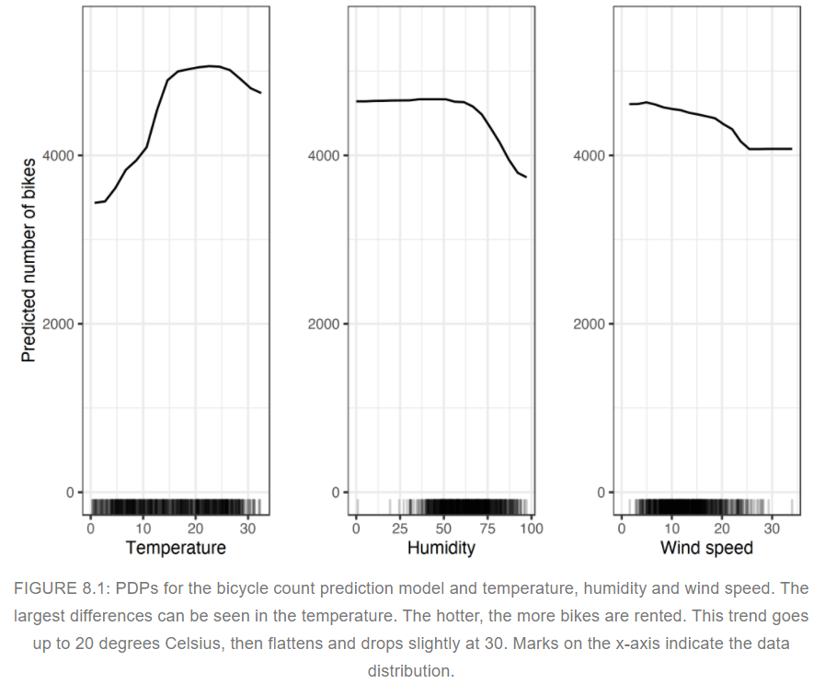
Partial Dependence As Explainable ML Tool
The partial dependence plot (short PDP or PD plot) shows the marginal effect one or two features have on the predicted outcome of a machine learning model (J. H. Friedman 2001)
Partial Dependence Plot (PDP)
https://www.youtube.com/watch?v=uQQa3wQgG_s&ab_channel=ritvikmath

Slide 58
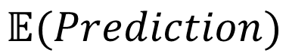
Partial Dependence Plot —— How?
X1 | X2 | X3 | Y
0 | 82 | 0.9 | 5
5 | 58 | 0.88 | 8
4 | 71 | 1.76 | 8
Original Dataset
X1 | X2 | X3
0 | 82 | 0.9
0 | 58 | 0.88
0 | 71 | 1.76
$$𝔼(Prediction)$$
Artificial Dataset

Slide 59

Thank You
FOR WATCHING AND LISTENING

